Slide 1
CS301 – Data Structures
Lecture No. 21
Data Structures Lecture No. 21
Reading Material
Data Structures and Algorithm Analysis in C++
Chapter. 4
4.4, 4.4.1
Summary
•
•
AVL Tree Building Example Cases for Rotation
AVL Tree Building Example
This lecture is a sequel of the previous one in which we had briefly discussed about building an AVL tree. We had inserted three elements in the tree before coming to the end of the lecture. The discussion on the same example will continue in this lecture. Let’s see the tree’s figures below:
1
-2
2
3
Fig 21.1: insert(3) single left rotation
2
1 3
Fig 21.2: insert(3)
Node containing number 2 became the root node after the rotation of the node having number 1. Note the direction of rotation here.
Let’s insert few more nodes in the tree. We will build an AVL tree and rotate the node
when required to fulfill the conditions of an AVL tree.
To insert a node containing number 4,we will, at first, compare the number inside the

Slide 2
CS301 – Data Structures Lecture No. 21
root node. The current root node is containing number 2. As 4 is greater than 2, it will take the right side of the root. In the right subtree of the root, there is the node containing number 3. As 4 is also greater than 3, it will become the right child of the node containing number 3.
2
1
3
4
Fig 21.3: insert(4)
Once we insert a node in the tree, it is necessary to check its balance to see whether it is within AVL defined balance. If it is not so, then we have to rotate a node. The balance factor of the node containing number 4 is zero due to the absence of any left or right subtrees. Now, we see the balance factor of the node containing number 3. As it has no left child, but only right subtree, the balance factor is –1. The balance factor of the node containing number 1 is 0. For the node containing number 2, the height of the left subtree is 1 while that of the right subtree is 2. Therefore, the balance factor of the node containing number 2 is 1 – 2 = -1. So every node in the tree in fig. 21.3 has balance factor either 1 or less than that. You must be remembering that the condition for a tree to be an AVL tree, every node’s balance needs not to be zero necessarily. Rather, the tree will be called AVL tree, if the balance factor of each node in a tree is 0, 1 or –1. By the way, if the balance factor of each node inside the tree is 0, it will be a perfectly balanced tree.
2
1
3
-2
4
Fig 21.4: insert(5)
5
Next, we insert a node containing number 5 and see the balance factor of each node. The balance factor for the node containing 5 is 0. The balance factor for node containing 4 is –1 and for the node containing 3 is -2. The condition for AVL is not satisfied here for the node containing number 3, as its balance factor is –2. The rotation operation will be performed here as with the help of an arrow as shown in the above Fig 21.4. After rotating the node 3, the new tree will be as under:

Slide 3
CS301 – Data Structures
Lecture No. 21
2
1
4
3
5
Fig 21.5: insert(5)
You see in the above figure that the node containing number 4 has become the right child of the node containing number 2. The node with number 3 has been rotated. It has become the left child of the node containing number 4. Now, the balance factor for different nodes containing numbers 5, 3 and 4 is 0. To get the balance factor for the node containing number 2, we see that the height of the left subtree containing number 2 is 1 while height of the right subtree is 2. So the balance factor of the node containing number 2 is –1. We saw that all the nodes in the tree above in Fig 21.5 fulfill the AVL tree condition.
If we traverse the tree Fig 21.5, in inorder tree traversal, we get: 1 2 3 4 5
Similarly, if we traverse the tree in inorder given in Fig 21.4 (the tree before we had
rotated the node containing number 3), following will be the output.
1 2 3 4 5
In both the cases above, before and after rotation, we saw that the inorder traversal of trees gives the same result. Also the root (node containing number 2) remained the same.
See the Fig 21.4 above. Considering the inorder traversal, we could arrange the tree in such a manner that node 3 becomes the root of the tree, node 2 as the left child of node 3 and node 1 as the left child of the node 2. The output after traversing the changed tree in inorder will still produce the same result:
1 2 3 4 5
While building an AVL tree, we rotate a node immediately after finding that that the node is going out of balance. This ensures that tree does not become shallow and remains within the defined limit for an AVL tree.
Let’s insert another element 6 in the tree. The figure of the tree becomes:

Slide 4
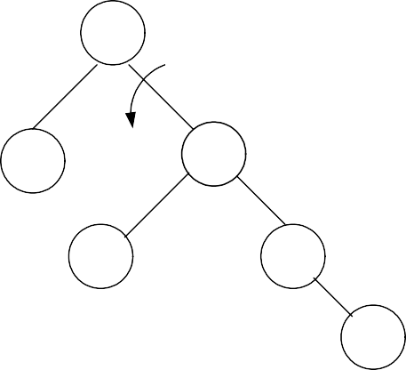
CS301 – Data Structures
Lecture No. 21
2
-2
1
4
3
5
Fig 21.6: insert(6)
6
The newly inserted node 6 becomes the right child of the node 5. Usually, after the insertion of a node, we will find out the node factor for each node and rotate it immediately. This is carried out after finding the difference out of limit. The balance factor for the node 6 is 0, for node 5 is –1 and 0 for node 3. Node 4 has –1 balance factor and node 1 has 0. Finally, we check the balance factor of the root node, node 2, the left subtree’s height is 1 and the right subtree’s height is 3. Therefore, the balance factor for node 2 is –2, which necessitates the rotation of the root node 2. Have a look on the following figure to see how we have rotated the node 2.
4
2
5
1
3
6
Fig 21.7: insert(6)
Now the node 4 has become the root of the tree. Node 2, which was the root node, has become the left child of node 4. Nodes 5 and 6 are still on their earlier places while remaining the right child and sub-child of node 4 respectively. However, the node 3, which was left child of node 4, has become the right child of node 2.
Now, let’s see the inorder traversal of this tree:
1 2 3 4 5 6
You are required to practice this inorder traversal. It is very important and the basic point of performing the rotation operation is to preserve the inorder traversal of the tree. There is another point to note here that in Binary Search Tree (BST), the root node remains the same (the node that is inserted first). But in an AVL tree, the root node keeps on changing.
In Fig 21.6: we had to traverse three links (node 2 to node 4 and then node 5) to reach the node 6. While after rotation, (in Fig 21.7), we have to traverse the two links (node

Slide 5
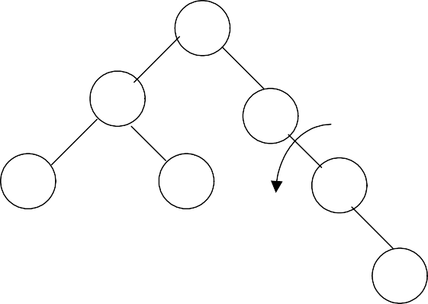
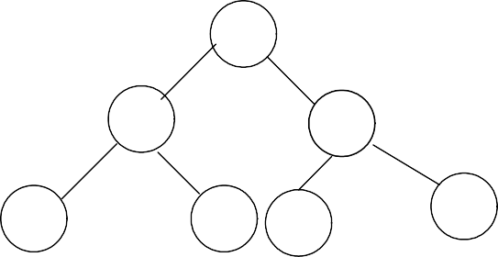
CS301 – Data Structures Lecture No. 21
4 and 5) to reach the node 6. You can prove it mathematically that inside an AVL tree built of n items; you can search up to 1.44log₂n levels to find a node inside. After this maximum number of links traversal, a programmer will have success or failure, as 1.44log₂n is the maximum height of the AVL tree. Consider the BST case, where we had constructed a linked list. If we want to build a BST of these six numbers, a linked list structure is formed. In order to reach the node 6, we will have to traverse five links. In case of AVL tree, we had to traverse two links only.
Let’s add few more items in the AVL tree and see the rotations performed to maintain AVL characteristics of the tree.
4
2
5
-2
1
3
6
Fig 21.8: insert(7)
7
Node 7 is inserted as the right child of node 6. We start to see the balance factors of
the nodes. The balance factors for node 7, 6 are 0 and –1 respectively. As the balance factor for node 5 is –2, the rotation will be performed on this node. After rotation, we get the tree as shown in the following figure.
4
2
6
1
3
5
7
Fig 21.9: insert(7)
After the rotation, node 5 has become the left child of node 6. We can see in the Fig
21.9 that the tree has become the perfect binary tree. While writing our program, we will have to compute the balance factors of each node to know that the tree is a perfectly balanced binary tree. We find that balance factor for all nodes 7, 5, 3, 1, 6, 2 and 4 is 0. Therefore, we know that the tree is a perfect balanced tree. Let’ see the inorder traversal output here:
1 2 3 4 5 6 7
It is still in the same sequence and the number 7 has been added at the end.

Slide 6
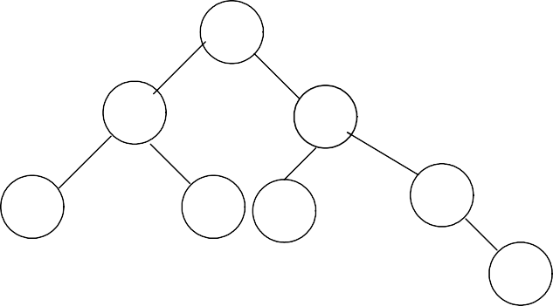
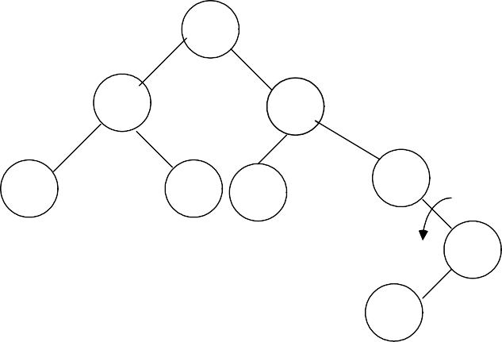
CS301 – Data Structures
Lecture No. 21
4
2
6
1
3
5
7
16
Fig 21.10: insert(16)
We have inserted a new node 16 in the tree as shown in the above Fig 21.10. This node has been added as the right child of the node 7. Now, let’s compute the balance factors for the nodes. The balance factor for nodes 16, 7, 5, 3, 1, 6, 2 and 4 is either 0 or –1. So this fulfills the condition of a tree to be an AVL. Let’s insert another node containing number 15 in this tree. The tree becomes as given in the figure below:
4
2
6
1
3
5
7
-2
16
15
Fig 21.11: insert(15)
Next step is to find out the balance factor of each node. The factors for nodes 5 and 16 are 0 and 1 respectively. This is within limits of an AVL tree but the balance factor for node 7 is –2. As this is out of the limits of AVL, we will perform the rotation operation here. In the above diagram, you see the direction of rotation. After rotation, we have the following tree:

Slide 7
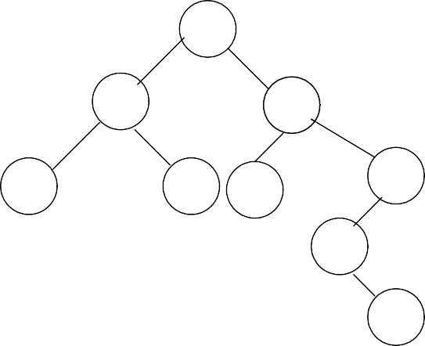
CS301 – Data Structures
Lecture No. 21
4
2
6
1
3
5
16
2
7
Fig 21.12: insert(15)
15
Node 7 has become the left child of node 16 while node 15 has attained the form of the right child of node 7. Now the balance factors for node 15, 7 and 16 are 0, -1 and 2 respectively. Note that the single rotation above when we rotated node 7 is not
enough as our tree is still not an AVL one. This is a complex case that we had not encountered before in this example.
Cases of Rotation
The single rotation does not seem to restore the balance. We will re-visit the tree and
rotations to identify the problem area. We will call the node that is to be rotated as α (node requires to be re-balanced). Since any node has at the most two children, and a height imbalance requires that α’s two sub-trees differ by two (or –2), the violation will occur in four cases:
1.
2.
3.
4.
An insertion into left subtree of the left child of α. An insertion into right subtree of the left child of α.
An insertion into left subtree of the right child of α. An insertion into right subtree of the right child of α.
The insertion occurs on the outside (i.e., left-left or right-right) in cases 1 and 4.
Single rotation can fix the balance in cases 1 and 4.
Insertion occurs on the inside in cases 2 and 3 which a single rotation cannot fix.

Slide 8
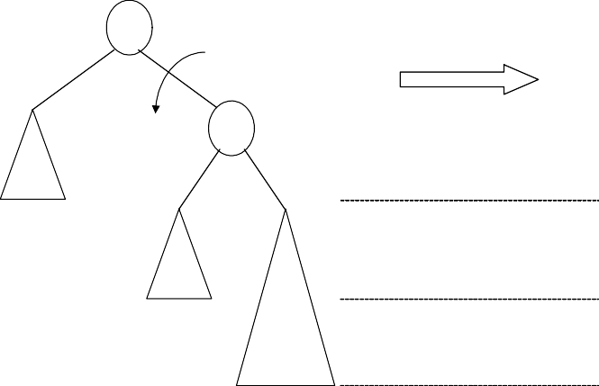
CS301 – Data Structures
Lecture No. 21
_{∇k} α
2
α
^{k}11
k₁
^{k}22
Z
Level n-2
X
X
Y
Level n-1
Y
Z
new
Level n
new
Fig 21.13: Single right rotation to fix case 1
We have shown, single right notation to fix case 1. Two nodes k2 and k1 are shown in the figure, here k2 is the root node (and also the α node, k1 is its left child and Z shown in the triangle is its right child. The nodes X and Y are the left and right subtrees of the node k1. A new node is also shown below to the triangle of the node X, the exact position (whether this node will be right or left child of the node X) is not mentioned here. As the new node is inserted as a child of X that is why it is called an outside insertion, the insertion is called inside if the new node is inserted as a child of the node Y. This insertion falls in case 1 mentioned above, so by our definition above, single rotation should fix the balance. The k2 node has been rotated single time towards right to become the right child of k1 and Y has become the left child of k2. If we traverse the tree in inorder fashion, we will see that the output is same:
X k1 Y k2 Z
Consider the the figure below:
^{k}11
k₂
X
^{k}22
^{k}21
Level n-2
Y
Level n-1
X
Y
Z
Z
Level n
Fig 21.14: Single left rotation to fix case 4
In this figure (Fig 21.14), the new node has been inserted as a child node of Z, that is why it is shown in bigger size covering the next level. Now this is an example of case 4 because the new node is inserted below the right subtree of the right child of the

Slide 9
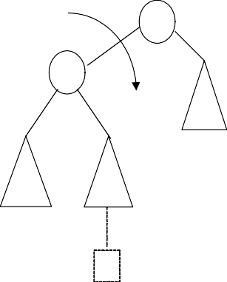
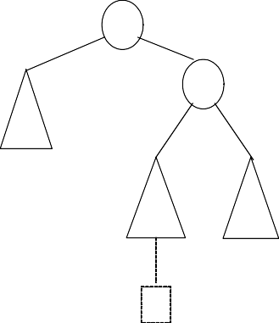
CS301 – Data Structures
Lecture No. 21
root node (α). One rotation towards should make it balanced within limits of AVL tree. The figure on the right is after rotation the node k1 one time towards left. This time node Y has become the right child node of the node k1.
In our function of insertion in our code, we will do insertion, will compute the balance factors for nodes and make rotations.
Now, we will see the cases 2 and 3, these are not resolved by a single rotation.
α α
k₂ k₁
^{k}12 ^{k}22
Z X
Level n-2
X
Y
Level n-1
Y
Z
new
Level n
new
Fig 21.15: Single right rotation fails to fix case 2
We see here that the new node is inserted below the node Y. This is an inside
insertion. The balance factor for the node k2 became 2. We make single rotation by making right rotation on the node k2 as shown in the figure on the right. We compute the balance factor for k1, which is –2. So the tree is still not within the limits of AVL tree. Primarily the reason for this failure is the node Y subtree, which is unchanged even after making one rotation. It changes its parent node but its subtree remains intact. We will cover the double rotation in the next lecture.
It is very important that you study the examples given in your text book and try to practice the concepts rigorously.

Slide 10
CS301 – Data Structures
Lecture No. 22
Data Structures Lecture No. 22
Reading Material
Data Structures and Algorithm Analysis in C++
Chapter. 4
4.4.2
Summary
•
•
•
•
Cases of rotations
Left-right double rotation to fix case 2 Right-left double rotation to fix case 3 C++ Code for avlInsert method
Cases of rotations
In the previous lecture, we discussed how to make insertions in the AVL tree. It was seen that due to the insertion of a node, the tree has become unbalanced. Resultantly, it was difficult to fix it with the single rotation. We have analyzed the insertion method again and talked about the α node. The new node will be inserted at the left or right subtree of the α’s left child or at the left or right subtree of the α’s right child. Now the question arises whether the single rotation help us in balancing the tree or not. If the new node is inserted in the left subtree of the α’s left child or in the right subtree of α’s right child, the balance will be restored through single rotation. However, if the new node goes inside the tree, the single rotation is not going to be successful in balancing the tree.
We face four scenarios in this case. We said that in the case-1 and case-4, single rotation is successful while in the case-2 and case-3 single rotation does not work. Let’s see the tree in the diagram given below.
Single right rotation fails to fix case 2.
α α
k₂ k₁
k₁
Z
k₂
Level n-2
X
X
Y
Level n-1
Y
Z
Level n
new new
In the above tree, we have α node as k2, which has a left child as k1. Whereas X and Y
are its left and right children. The node k2 has a right child Z. Here the newly inserted

Slide 11
CS301 – Data Structures Lecture No. 22
node works as the left or right child of node Y. Due to this insertion, one level is increased in the tree. We have applied single rotation on the link of k1 and k2. The right side tree in the figure is the post-rotation tree. The node k1 is now at the top while k2 comes down and node Y changes its position. Now if you see the levels of the node, these are seen same. Have a look on the level of the α node i.e. k1 which reflects that the difference between the left and right side levels is still 2. So the single rotation does not work here.
Let’s see how we can fix that problem. A fresh look on the following diagram will help us understand the problem.
k₂
k₁
Z
X
Y
Here k2 is the root node while k1 and Z are the right and left children respectively. The new node is inserted under Y so we have shown Y in a big triangle. The new node is inserted in the right subtree of k1, increasing its level by 1. Y is not empty as the new node was inserted in it. If Y is empty, the new node will be inserted under k1. It means that Y has a shape of a tree having a root and possibly left and right subtrees. Now view the entire tree with four subtrees connected with 3 nodes. See the diagram below.

Slide 12
CS301 – Data Structures
Lecture No. 22
k₃
k₁
D
k₂
A
B
C
We have expanded the Y and shown the root of Y as K2, B and C are its left and right subtrees. We have also changed the notations of other nodes. Here, we have A, B, C and D as subtrees and k1, k2 and k3 as the nodes. Let’s see where the new node is inserted in this expanded tree and how can we restore its balance. Either tree B or C is two levels deeper than D. But we are not sure which one is deeper. The value of new node will be compared with the data in k2 that will decide that this new node should be inserted in the right subtree or left subtree of the k2. If the value in the new node is greater than k2, it will be inserted in the right subtree i.e. C. If the value in the new node is smaller than k2, it will be inserted in the left subtree i.e. B. See the diagram given below:

Slide 13
CS301 – Data Structures
Lecture No. 22
k₃
k₁
k₂
D
A
1
B
C
2
new new’
New node inserted at either of the two spots
We have seen the both possible locations of the new node in the above diagram. Let’s see the difference of levels of the right and left subtrees of the k3. The difference of B or C from D is 2. Therefore the expansion of either of B or C, due to the insertion of the new node, will lead to a difference of 2. Therefore, it does not matter whether the new node is inserted in B or C. In both of the cases, the difference becomes 2. Then we try to balance the tree with the help of single rotation. Here the single rotation does not work and the tree remains unbalanced. To re-balance it, k3 cannot be left as the root. Now the question arises if k3 cannot become root, then which node will become root? In the single rotation, k1 and k3 were involved. So either k3 or k1 will come down. We have two options i.e. left rotation or right rotation. If we turn k1 into a root, the tree will be still unbalanced. The only alternative is to place k2 as the new root. So we have to make k2 as root to balance the tree. How can we do that?
If we make k2 the root, it forces k1 to be k2‘s left child and k3 to be its right child. When we carry out these changes, the condition is followed by the inorder traversal. Let’s see the above tree in the diagram. In that diagram, the k3 is the root and k1 is its left child while k2 is the right child of k1. Here, we have A, B, C and D as subtrees. You should know the inorder traversal of this tree. It will be A, k1, B, k2, C, k3 and D where A, B, C and D means the complete inorder traversal of these subtrees. You should memorize this tree traversal.

Slide 14
CS301 – Data Structures
Lecture No. 22
Now we have to take k2 as the root of this tree and rearrange the subtrees A, B, C and
D. k1 will be the left child of k2 while k3 is going to be its right child. Finally if we traverse this new tree, it will be the same as seen above. If it is not same, it will mean that there is something wrong in the rotation. We have to find some other solution. Now let’s see how we can rotate our tree so that we get the desired results.
Left-right double rotation to fix case 2
We have to perform a double rotation to achieve our desired results. Let’s see the diagram below:
Left-right double rotation to fix case 2.
k₃
k₃
k₁
Rotate left
k₂
k₂
k₁
D
D
C
A
B
C
1
B
2
A
new’
new
new’
new
On the left side, we have the same tree with k3 as its root. We have also shown the new nodes as new and new’ i.e. the new node will be attached to B or C. At first, we will carry out the left rotation between k1 and k2. During the process of left rotation, the root k1 comes down and k2 goes up. Afterwards, k1 will become the left child of k2 and the left subtree of k2 i.e. B, will become the right subtree of k1. This is the
single rotation. You can see the new rotated tree in the above figure. It also shows that the B has become the right child of the k1. Moreover, the new node is seen with the B. Now perform the inorder traversal of this new rotated tree. It is A, k1, B, k2, C, k3 and
D. It is same as witnessed in case of the inorder traversal of original tree. With this single rotation, the k2 has gone one step up while k1 has come down. Now k2 has become the left child of k3. We are trying to make the k2 the root of this tree. Now
what rotation should we perform to achieve this?
Now we will perform right rotation to make the k2 the root of the tree. As a result, k1 and k2 have become its left and right children respectively. The new node can be inserted with B or C. The new tree is shown in the figure below:

Slide 15
CS301 – Data Structures
Lecture No. 22
k₃
Rotate right
k₂
k₂
k₁
k₃
k₁
D
C
B
C
B
A
D
A
new’
new
new’
new
Now let’s see the levels of new and new’. Of these, one is the new node. Here you can see that the levels of new, new’ i.e. A and D are the same. The new tree is now a balanced one. Let’s check the inorder traversal of this tree. It should be the same as
that of the original tree. The inorder traversal of new tree is A, k1, B, k2, C, k3 and D, which is same as that of the original tree.
This is known as double rotation. In double rotation, we perform two single rotations. As a result, the balance is restored and the AVL condition is again fulfilled. Now we will see in which order, the double rotation is performed? We performed a left rotation between k1 and k2 link, followed by a right rotation.
Right-left double rotation to fix case 3
In case, the node is inserted in left subtree of the right child, we encounter the same situation as discussed above. But here, we will perform right rotation at first before going for a left rotation. Let’s discuss this symmetric case and see how we can apply double rotation here. First we perform the right rotation.

Slide 16
CS301 – Data Structures
Lecture No. 22
Right-left double rotation to fix case 3.
k₁
Rotate right
k₁
k₃
k₂
A
A
k₂
D
k₃
B
B C C
D
Here k1 is the root of the tree while k3 is the right child of the k1. k2 is the inner child. It is the Y tree expanded again here and the new node will be inserted in the k2’s right
subtree C or left subtree B. As we have to transform the k2 into the root of the tree, so the right rotation between the link k2 and k3 will be carried out. As a result of this rotation, k2 will come up and k3 will go down. The subtree B has gone up with the k2
while subtree C is now attached with the k3. To make the k2 root of the tree, we will perform the left rotation between then k1 and k2. Let’s see this rotation in the figure below:
Rotate left
k₁ k₂
k₂ k₁
k₃
A
k₃
B
C
D
B
A
C
D
In the above figure at the right side, we have the final shape of the tree. You can see that k2 has become the root of the tree. k1 and k3 are its left and right children
respectively. While performing the inorder traversal, you will see that we have preserved our inorder traversal.
We have started this activity while building an example tree. We inserted numbers in it. When the balance factor becomes more than one, rotation is performed. During this process, we came at a point when single rotation failed to balance the tree. Now there is need to perform double rotation to balance the tree that is actually two single rotations. Do not take double rotation as some complex function, it is simply two single rotations in a special order. This order depends on the final position of the new

Slide 17
CS301 – Data Structures
Lecture No. 22
node. Either the new node is inserted at the right subtree of the left child of α node or at the left subtree of the right child of α node. In first case, we have to perform left- right rotation while in the second case, the right-left rotation will be carried out.
Let’s go back to our example and try to complete it. So far, we have 1, 2, 3, 4, 5, 6, 7 and 16 in the tree and inserted 15 which becomes the left child of the node 16. See the figure below:
4
2
6
1
3
5
7
k₁
16 k₂
X
(null)
Y
Z
(null)
15
Here we have shown X, Y and Z in case of the double rotation. We have shown Y expanded and 15 is inside it. Here we will perform the double rotation, beginning with the right rotation first.

Slide 18
CS301 – Data Structures
Lecture No. 22
4
2
6
k₁
7
1
3
5
k₃
16
k₂
15
Rotate right
We have identified the k1, k2 and k3 nodes. This is the case where we have to perform right-left double rotation. Here we want to promote k2 upwards. For this purpose, the right rotation on the link of k2 and k3 i.e. 15 and 16 will be carried out.
4
2
6
k₁
7
1
3
5
Rotate left
k₂
15
k₃
16
The node 15 now comes up while node 16 has gone down. We have to promote k2 to the top and k3 and k1 will become its right and left children respectively. Now we will

Slide 19
CS301 – Data Structures Lecture No. 22
perform left rotation on the link of k1 and k2 i.e. 7 and 15. With this left rotation, 15 goes up and 7 and 16 become its left and right children respectively.
4
2
6
k₂
15
1
3
5
k₁
7
k₃
16
Here we have to check two things. At first, the tree is balanced or not i.e. the AVL condition is fulfilled or not. Secondly we will confirm that the inorder traversal is preserved or not. The inorder traversal should be the same as that of the inorder traversal of original tree. Let’s check these two conditions. The depth of the left subtree of node 4 is 2 while the depth of the right subtree of node 4 is three. Therefore, the difference of the levels at node 4 is one. So the AVL condition is fulfilled at node 4. At node 6, we have one level on it left side while at the right side of node 6, there are two levels. As the difference of levels is one, therefore node 6 is also balanced according to the AVL condition. Similarly other nodes are also fulfilling the AVL condition. If you see the figure above, it is clear that the tree is balanced.
We are doing all this to avoid the link list structure. Whenever we perform rotation on the tree, it becomes clear from the figure that it is balanced. If the tree is balanced, in case of searching, we will not have to go very deep in the tree. After going through the mathematical analysis, you will see that in the worst case scenario, the height of the tree is 1.44 log₂ n. This means that the searching in AVL is logarithmic. Therefore if there are ten million nodes in an AVL tree, its levels will be roughly as log₂(10 million) which is very few. So the traversal in an AVL tree is very simple.
Let’s insert some more nodes in our example tree. We will perform single and double rotations, needed to make the tree balanced. The next number to be inserted is 14. The position of node 14, according to the inorder traversal, is the right child of 7. Let’s see this in the diagram as:

Slide 20
CS301 – Data Structures
Lecture No. 22
4
k₁
6
2
k₃
15
1
3
5
k₂
7
Rotate right
16
14
The new node 14 is inserted as the right child of 7 that is the inner subtree of 15. Here we have to perform double rotation again. We have identified the k1, k2 and k3. k2 has to become the root of this subtree. The nodes k1 and k3 will come down with their subtrees while k2 is going to become the root of this subtree. After the right rotation the tree will be as:
4
k₁
6
2
Rotate left
k₂
7
k₃
15
1
3
5
14
16

Slide 21
CS301 – Data Structures Lecture No. 22
With the right rotation, k2 has come one step up while k3 has been turned into the right child of k2 but k1 is still up. Now we will perform a left rotation on the link of k1 and k2 to make the k2 root of this subtree. Now think that after this rotation and rearrangement of node what will be the shape of the tree.
After the double rotation, the final shape of the tree will be as:
4
k₂
7
2
k₁
6
k₃
15
1
3
5
14
16
k2 has become the root of the subtree. k1 has attained the role of the left child of k2 and k3 has become the right child of the k2. The other nodes 5, 14 and 16 have been rearranged according to the inorder traversal. The node 7 has come up where as node 6 and 15 have become its left and right child. Now just by viewing the above figure, it is clear that the tree is balanced according to the AVL condition. Also if we find out its inorder traversal, it should be the same as the inorder traversal of original tree. The inorder traversal of the above tree is 1, 2, 3, 4, 5, 6, 7, 14, 15, and 16. This is in sorted order so with the rotations the inorder traversal is preserved.
Let’s insert some more numbers in our tree. The next number to be inserted is 13.

Slide 22
CS301 – Data Structures
Lecture No. 22
4
Rotate left
2
7
1
3
6
15
5
14
16
13
We have to perform single rotation here and rearrange the tree. It will look like as:
7
4
15
2
6
14
16
1 3
5
13
The node 7 has become the root of the tree. The nodes 4, 2, 1, 3, 6, 5 have gone to its left side while the nodes 15, 14, 13, 16 are on its right side. Now try to memorize the tree which we build with these sorted numbers. If you remember that it looks like a link list. The root of that tree was 1. After that we have its right child as 2, the right child of 2 as 3, then its right child 4 and so on up to 16. The shape of that tree looks exactly like a linked list. Compare that with this tree. This tree is a balanced one. Now if we have to traverse this tree for search purposes, we have to go at the most three levels.
Now you must be clear why we need to balance the trees especially if we have to use the balanced search trees. While dealing with this AVL condition, it does not matter

Slide 23
CS301 – Data Structures Lecture No. 22
whether the data, provided to a programmer is sorted or unsorted. The data may be sorted in ascending order or descending order. It may contain alphabets or names in any order. We will keep our tree balanced during the insertion and tree will be balanced at each point. Our tree will not be balanced in the end, it will be balanced with each insertion. It will not be completely balanced. At the maximum, if we pick any node, the difference in the levels of its right subtree and left subtree will not be more than 1.
Now if we have 9 or 10 nodes in the tree and take log of this, it will be near 3. Therefore our tree has three levels after that there are its leaf nodes. Please keep this in mind that originally we have thought BST as an abstract data type. We have defined operations on it like insert, remove and the major method was find. The find method takes a data item and searches the tree. It will also show that this data item exists or not in the tree. We also right findMin and findMax methods. In case of a BST, we can find the minimum and maximum value in it. The minimum will be the left most node of the tree while the right most node of BST will give the maximum value. You can confirm it by applying this on the above tree.
C++ Code for avlInsert method
Now let’s see the C++ code of avlinsert method. Now we have to include this balancing procedure in the insert method. We have already written this insert method which takes some value and adds a node in the tree. That procedure does not perform balancing. Now we will include this balancing feature in our insert method so that the newly created tree fulfills the AVL condition.
Here is the code of the function.
/* This is the function used to insert nodes satisfying the AVL condition.*/
TreeNode<int>* avlInsert(TreeNode<int>* root, int info)
{
if( info < root->getInfo() ){
root->setLeft(avlInsert(root->getLeft(), info));
int htdiff = height(root->getLeft()) – height(root->getRight()); if( htdiff == 2 )
if( info < root->getLeft()->getInfo() ) // outside insertion case
root = singleRightRotation( root ); else // inside insertion case
root = doubleLeftRightRotation( root );
}
else if(info > root->getInfo() ) {
root->setRight(avlInsert(root->getRight(),info));
int htdiff = height(root->getRight()) – height(root->getLeft()); if( htdiff == 2 )
if( info > root->getRight()->getInfo() ) root = singleLeftRotation( root );
else
root = doubleRightLeftRotation( root );
}

Slide 24
CS301 – Data Structures Lecture No. 22
// else a node with info is already in the tree. In
// case, reset the height of this root node.
int ht = Max(height(root->getLeft()), height(root->getRight())); root->setHeight( ht + 1 ); // new height for root.
return root;
}
We have named the function as avlInsert. The input arguments are root node and the info is of the type int. In our example, we are having a tree of int data type. But of course, we can have any other data type. The return type of avlInsert method is TreeNode<int>*. This info will be inserted either in the right subtree or left subtree of root. The first if statement is making this decision by comparing the value of info and the value of root. If the new info value is less than the info value of root, the new node will be inserted in the left subtree of root. In the next statement, we have a recursive call as seen in the following statement.
avlInsert(root->getLeft(), info)
Here we are calling avlInsert method again. We are passing it the first node of the left subtree and the info value. We are trying to insert this info in the left subtree of root if it does not already exist in it. In the same statement, we are setting the left of root as the return of the avlInsert method. Why we are doing setLeft? As we know that this is an AVL tree and the new data is going to be inserted in the left subtree of root. We have to balance this tree after the insertion of the node. After insertion, left subtree may be rearranged to balance the tree and its root can be changed. You have seen the previous example in which node 1 was the root node in the start and in the end node 7 was its root node. During the process of creation of that tree, the root nodes have been changing. After the return from the recursive call in our method, the left node may be different than the one that was before insertion. The complete call is as:
root->setLeft(avlInsert(root->getLeft(), info));
Here we are inserting the new node and also getting the root of the left subtree after the insertion of the new node. If the root of the left subtree has been changed after the insertion, we will update our tree by assigning this new left-node to the left of the root.
Due to the insertion of the new node if we have rearranged the tree, then the balance factor of the root node can be changed. So after this, we check the balance factor of the node. We call a function height to get the height of left and right subtree of the root. The height function takes a node as a parameter and calculates the height from that node. It returns an integer. After getting the heights of left and right subtrees, we take its difference as:
int htdiff = height(root->getLeft()) – height(root->getRight());
Now if the difference of the heights of left and right subtrees is greater than 1, we have to rebalance the tree. We are trying to balance the tree during the insertion of new node in the tree. If this difference is 2, we will perform single rotation or double

Slide 25
CS301 – Data Structures Lecture No. 22
rotation to balance the tree. We have to deal with one of the four cases as discussed earlier. This rotation will be carried out with only one node where the balance factor is 2. As a result, the tree will be balanced. We do not need to rotate each node to balance the tree. This is characteristic of an AVL tree.
We have seen these rotations in the diagrams. Now we have to perform these ones in the code. We have four cases. The new node is inserted in the left or right subtree of the left child of α node or the new node is inserted in the left or right subtree of the right child of α node. How can we identify this in the code? We will identify this with the help of the info value of the new node.
We can check whether the difference (htdiff) is equal to 2 or not. We have if condition that checks that the info is less than the value of left node of the current node (α node). If this condition is true, it shows that it is the case of outside insertion. The node will be inserted as the left-most child. We have to perform single rotation. If the else part is executed, it means that this is the case of inside insertion. So we have to perform double rotation. We are passing α node to the rotation function. When a programmer performs these rotations, he gets another node that is assigned to root. This is due to the fact that the root may change during the rotations.
We encounter this case when the new node is inserted in the left subtree of the root. The new node can be inserted in the right subtree of the root. With respect to symmetry, that code is also similar. You can easily understand that. In the code, we have if-else condition that checks whether the info is greater than the value of root. Therefore, it will be inserted in the right subtree. Here again, we made a recursive call to avlInsert by passing it the first node of the right subtree of the root. When this recursive call is completed, we may have to perform rotations. We set the right node of the root as the node returned by the avlInsert. After this, we check the balance factor. We calculate the difference as:
int htdiff = height(root->getRight()) – height(root->getLeft());
In the previous case, we have subtracted the height of right tree from left tree. Here we have subtraction the height of left tree from the right tree. This is due to the fact that we want to avoid the -ve value. But it does not matter whether we get the -ve value. We can take its absolute value and test it. If the value of htdiff is 2 , we have to identify the case. We check that the new node is to be inserted in the right subtree of the right child of α node or in the left subtree of the right child of α node. If the info is greater than the value of the right child of root, it is the case 4. Here we will restore the balance of the tree by performing single rotation. If the else part is executed, we have to perform the double rotation. These rotation routines will return the root of the rearranged tree that will be set as a root.
In the end, we have the third case. This is the case when the info is equal to the root. It means that the data is already in the tree. Here we will readjust the height if it is needed. We will take the maximum height between the left and right subtree and set this height plus one as the height of the root. We have added one to the height after adding one node to the tree. In the end, we return the root. We have included the balancing functionality in our tree and it will remain balanced.

Slide 26
CS301 – Data Structures Lecture No. 22
We have not seen the code of rotation routines so far. The code of these methods is also very simple. We have to move some of pointers. You can easily understand that code. We will discuss this in the next lecture. Please see the code of single and double rotation in the book and try to understand it.

Slide 27
CS301 – Data Structures
Lecture No. 23
Data Structures Lecture No. 23
Reading Material
Data Structures and Algorithm Analysis in C++
Chapter. 4
4.4.1, 4.4.2
Summary
Single Right Rotation
Single Left Rotation
Double Right-Left Rotation
Double Left- Right Rotation
Deletion in AVL Tree
Cases of Deletion in AVL Tree
We demonstrated how to write the insert procedure for an AVL tree in the previous lecture. The single and double rotation call methods were also discussed at length. While inserting a node if we see that the tree is going to be unbalanced, it means that the AVL condition is being violated. We also carried out the balancing of the tree by calling single or double rotation. Now let’s see the code of these routines i.e. single and double rotation.
Single Right Rotation
At first, we will discuss the code of SingleRightRotation function. Its argument is TreeNode, which is given the name k2. The reason of using k2 is that it alongwtih k1 etc was used in the earlier discussion. After the rotation, this function will return a pointer, as tree will be re-organized. Resultantly, its root will be changed. Following is the code of this SingleRightRotation function.
TreeNode<int>* singleRightRotation(TreeNode<int>* k2)
{
if( k2 == NULL ) return NULL;
// k1 (first node in k2's left subtree) will be the new root TreeNode<int>* k1 = k2->getLeft();
// Y moves from k1's right to k2's left k2->setLeft( k1->getRight() );
k1->setRight(k2);
// reassign heights. First k2
int h = Max(height(k2->getLeft()), height(k2->getRight()));

Slide 28
CS301 – Data Structures Lecture No. 23
k2->setHeight( h+1 );
// k2 is now k1's right subtree
h = Max( height(k1->getLeft()), k2->getHeight()); k1->setHeight( h+1 );
return k1;
}
In the function, at first, we check whether k2 is NULL. If it is NULL, the function is exited by returning NULL. If it is not NULL, the rotation process starts. The figure below depicts the single right rotation process. In this diagram, we see that k2 has been shown as the root node to this function. We see that k1 is the left subtree of k2.
k₂
k₁
Z
Y
X
Fig 23.1: Single Right Rotation
We are going to apply single right rotation on the link between k1 and k2. The node k1 will be the new root node after rotation. So we get its value by the following statement
TreeNode <int>* k1 = k2 -> getLeft() ;
Due to the single right rotation, k2 has come down, resulting in the upward movement of k1. The tree Y has to find its new place. The place of the trees X and Z remains intact. The change of place of Y is written in the code as below.
k2->setLeft( k1->getRight() );
In the above statement, we get the right child of k1 (i.e. k1 -> getRight() ) i.e. Y and pass it to setLeft function of k2. Thus it becomes the left child of k2. By the statement
k1 -> setRight (k2) ;
We set the node k2 as right child of k1. Now after these three statements, the tree has been transformed into the following figure.

Slide 29
CS301 – Data Structures
Lecture No. 23
k₁
k₂
X
Y
Z
Fig 23.2: Tree after rotation
From the above figure, it is reflected that k1 is now the root of the tree while k2 is its right child. The Y, earlier the right subtree of k1 (see fig 23.1), has now become the right subtree of k2. We see that the inorder traversal of this tree is X k1 Y k2 Z. It is the same as of the tree before rotation in fig 23.1 i.e. X k1 Y k2 Z.
Now we set the heights of k1 and k2 in this re-arranged tree. In the code, to set the height of k2, we have written
int h = Max(height(k2->getLeft()) , height(k2->getRight())); k2->setHeight( h+1 );
Here we take an integer h and assign it a value. This value is the maximum height among the two subtrees i.e. height of left subtree of k2 and height of right subtree of k2. Then we add 1 to this value and set this value as the height of k2. We add 1 to h as the height of root is one more than its child.
Similarly we set the height of k1 and get the heights of its left and right subtrees
before finding the higher value of these two by the Max function. Afterwards, we add 1 to this value and set this value as the height of k1. The following two statements perform this task.
h = Max( height(k1->getLeft()), k2->getHeight()); k1->setHeight( h+1 );
In the end, we return the root node i.e. k1. Thus the right single rotation is completed. In this routine, we saw that this routine takes root node of a tree as an argument and then rearranges it, resets the heights and returns the new root node.
Height Function
In the above SingleRightRotation, we used the height routine. This routine calls the getHeight function for the argument passed to it and returns the value got from that function. If there is an empty tree, then by definition its height will be -1. So in this routine, we return the value -1 if the argument passed to it is NULL. Following is the code of this routine.

Slide 30
CS301 – Data Structures
Lecture No. 23
int height( TreeNode<int>* node )
{
if( node != NULL ) return node->getHeight(); return –1;
}
Single Left Rotation
This rotation is almost similar to the single right rotation. We start from k1. k1 is the root while k2 is its right child. Due to the left rotation, the right child k2 of the root k1 will become the root. The k1 will go down to the left child of k2. The following figure shows that we have to change the positions of some pointers. The condition of the tree before and after single left rotation is also seen.
k₁
k₂
X
k₂
k₁
Y
X
Y
Z
Z
Fig 23.3: Single Left Rotation
Following is the code of the function performing the single left rotation.
TreeNode<int>* singleLeftRotation( TreeNode<int>* k1 )
{
if( k1 == NULL ) return NULL;
// k2 is now the new root TreeNode<int>* k2 = k1->getRight(); k1->setRight( k2->getLeft() ); // Y
k2->setLeft( k1 );
// reassign heights. First k1 (demoted)
int h = Max(height(k1->getLeft()), height(k1->getRight())); k1->setHeight( h+1 );
// k1 is now k2's left subtree
h = Max( height(k2->getRight()), k1->getHeight()); k2->setHeight( h+1 );
return k2;

Slide 31
CS301 – Data Structures
Lecture No. 23
}
In the above code, it is evident that if the node passed to the function is not NULL (that means k1 is not NULL), we assign to k2 the value of k1 -> getRight (). Now in the rotation, Y tree i.e. the left subtree of k2, becomes the right subtree of k1. We write it in the next statement as.
k1->setRight( k2->getLeft() );
In this statement, we get the left child of k2 i.e. Y and set it as the right child of k1. Afterwards, k1 is set as the left child of k2. The following statement reflects this process.
k2->setLeft( k1 );
After single left rotation, the k2 becomes the root node after going up. However, k1 goes down as the left child of k2. The tree Y, earlier the left child of k2 has, now become the right child of k1.X and Z continue to remain at the previous positions. The tree has been transformed with changes into the heights of k1 and k2. We re- assign the heights to these nodes in line with the process adopted in the right single rotation. At first, we adjust the height of k1. We get the heights of left and right subtrees of k1. The greater of these is taken and assigned to an int h. Then we add 1 to this value and set it as the height of k1. The following two lines of the code execute this task.
int h = Max(height(k1->getLeft()), height(k1->getRight())); k1->setHeight( h+1 );
Similarly, we adjust the height of k2 by getting the greater one among the heights of its right subtree and its left subtree. Taking k1 as its left subtree, we get the height of k1. We add 1 and set it as the height of k2. Following are the statements that perform this task.
h = Max( height(k2->getRight()), k1->getHeight()); k2->setHeight( h+1 );
Finally, k2 is returned as the root of the tree.
Double Right-Left Rotation
As obvious from the nomenclature, in the double rotation, we at first carry out the right rotation before going ahead with the left rotation. Let’s say that we pass it the node k1. Look at the following figure to see what are the nodes k1, k2 and k3. The figure 23.4 shows the first step (A) of double right-left rotation that is the single right rotation. It shows the rearranged tree on the right side in the figure.

Slide 32
CS301 – Data Structures
Lecture No. 23
k₁
k₁
k₃
k₂
A A
k₂
D
B
k₃
B
C
C
D
Fig 23. 4: Double Right-Left Rotation (A)
In the left portion of the above figure, we see that k1 is the root of the tree. k3 is the right child of k1 while k2 is the left child of k3. A, B, C and D are trees. We carry out the right rotation between the link of k3 and k2. In the code, it is shown that if k1 is not NULL, we go ahead and perform the rotation. The code of this double rotation is given below.
TreeNode<int>* doubleRightLeftRotation(TreeNode<int>* k1)
{
if( k1 == NULL ) return NULL;
// single right rotate with k3 (k1's right child)
k1->setRight( singleRightRotation(k1->getRight()));
// now single left rotate with k1 as the root return singleLeftRotation(k1);
}
We perform the right rotation with the help of k3. Now think about the single right rotation. We are at k3 and its left child k2 will be involved in the rotation. In the code, for the single right rotation, we have written
k1->setRight( singleRightRotation(k1->getRight()));
Here, we are passing the right child of k1 (i.e. k3) to the single right rotation. The function singleRightRotation itself will find the left child of k3 to perform the single right rotation. The singleRightRotation will take k3 downward and bring up its left child i.e. k2. The left subtree of k2 i.e. C, now becomes the right subtree of k3. Due to this single right rotation, the tree will be transformed into the one, shown in the right

Slide 33
CS301 – Data Structures Lecture No. 23
part of the figure 23.4.
After this we apply the single left rotation on this tree that is got from the single right rotation. This single left rotation is done by passing it k1. In this rotation, k1 goes down and k2 i.e. the right child of k1, becomes the root. We return the result of single left rotation. The following statement in the above code performs this task.
return singleLeftRotation(k1);
Thus the tree gets its final form i.e. after the double right-left rotation. The following figure shows the single left rotation and the final form of the tree.
k₁
k₂
k₂
k₁
k₃
A
k₃
B
A
B
C
D
C
D
Fig 23.5: Double right-left rotation (B)
In the above figure, it was witnessed that the double rotation consists of few
statements. That’s why, we have had written the routines for single right and left rotations. In the double right-left rotation, we just carried out a single right rotation and the single left rotation to complete the double right-left rotation.
Double Left-Right Rotation
While performing the double left-right rotation, we simply carry out the single left rotation at first. It is followed by the single right rotation. Following is the code of the double Left-Right rotation.
TreeNode<int>* doubleLeftRightRotation(TreeNode<int>* k3)
{
if( k3 == NULL ) return NULL;
// single left rotate with k1 (k3's left child)
k3->setLeft( singleLeftRotation(k3->getLeft()));
// now single right rotate with k3 as the root return singleRightRotation(k3);

Slide 34
CS301 – Data Structures
Lecture No. 23
}
In the above code, we receive the argument node as k3. As we have to do the left rotation first, it is applied to the left child of k3. From the figure below (Fig 23.6), we see that the left child of k3 is k1. However, when we send k1 to the singleLeftRotation it will take the right child of k1 i.e. k2. This process will rotate the link between k1and k2. The tree formed as a result of this single left rotation, is shown at the right side in the figure 23.6.
k₃
k₃
k₂
k₁
D
D
k₂
k₁
A
C
B
C
A
B
Fig 23.6: Double left-right rotation (A)
In this new rearranged tree, k2 comes up while k1 goes down, becoming the left subtree of k2. The subtree B, earlier left subtree of k2, now becomes the right subtree of k1.
The second step in the double left-right rotation is to apply the single right rotation on this new tree. We will carry out the single right rotation on k3. The pictorial representation of this single right rotation on k3 is given in the figure below.
k₃
k
2
k₂
D
k₁
k₃
k₁
C
A
B
C
D
A
B
Fig 23.7: Double left-right rotation (B)

Slide 35
CS301 – Data Structures
Lecture No. 23
In the code, we wrote the statement for this as below.
return singleRightRotation(k3);
We pass k3 to the singleRightRotation. It is, internally applied to the left child of k3 ie. k2. Now due to the right rotation, k2 will come up and k3 will become its right child. The node k1 will remain the left child of k2. The subtree C that was the right subtree of k2, will now be the left subtree of k3.
By now, the discussion on the insert routine has been completed. We have written the insert routine so that data item could be passed to it and inserted at a proper position in the tree. After inserting a node, the routine checks the balance or height factors and does the left or right rotation if needed and re-balances the tree.
Note that a property of the AVL tree is that while inserting a node in an AVL tree if we have to balance the tree then we have to do only one single right or left rotation or one double rotation to balance the tree. There is no such situation that we have to do a number of rotations. We do the one single or one double rotation at the node whose balance has become 2 after inserting a node.
Deletion in AVL Tree
The deletion of a data item from a data structure has always been difficult whatever data structure we use. The deletion is the inverse of insertion. In deletion there is a given value x and an AVL tree T. We delete the node containing the value x and rebalance the tree if it becomes unbalance after deleting the node. We will see that the deletion of a node is considerably more complex than the insertion of a node. It is complex in the sense that we may have to do more than one rotations to rebalance the tree after deleting a node. We will discuss the deletion case by case and will see that about what points we have to take care in the deletion process.
We are not going to write the code for deletion here. If we have to use AVL tree routines or class, the deletion and insertion routines of AVL tree are available in standard library. We can use these routines in our program. We have no need to write these routines. But here we discuss these to understand their functionality.
We know that insertion in a height-balanced tree requires at most one single rotation
or one double rotation. We do this rotation at the node whose balance violates the AVL condition. We can use rotations to restore the balance when we do a deletion. If the tree becomes unbalance after deleting a node then we use rotations to rebalance it. We may have to do a rotation at every level of the tree. Thus in the worst case of deletion we have to do log₂ N rotations. As log₂ N is the number of levels of a tree of
N nodes.
Let’s consider an example of deleting a node from a tree. In this example, we will discuss the worst case of deletion that is we have to do rotation at each level after deleting a node. Look at the following figure i.e. Fig 23.8. In this figure the root of the tree is node N and we have expanded only the left subtree of this node. The right subtree of it is indicated by a triangle. We focus on the left subtree of N. The balance of each non-leaf node of the left subtree of N is –1. This means that at every non-leaf node the depth/height of left subtree is one shorter than the height of right subtree. For example look at the node C. The left subtree of C is one level deep where as it’s right subtree is two levels deep. So balance of it is 1 – 2 = -1. If we look at node I its left

Slide 36
CS301 – Data Structures Lecture No. 23
subtree has height 2 as there are two levels where nodes G and H exists. The right subtree of I has number of levels (i.e. height) 3 where exists the nodes K, L and M respectively. Thus the balance of I is 2 – 3 = -1. Similarly we can see that other nodes also have the balance –1. This tree is shown in the following figure.
N
F
C
I
A
D
G
K
E
H
J
L
M
Fig 23.8: Tree under consideration
Here in this tree, the deletion of node A from the left subtree causes the worst case of deletion in the sense that we have to do a large number of rotations. Now we delete the node A from the tree. The effect of this deletion is that if we consider the node C the height of its left subtree is zero now. The height of the right subtree of C is 2. Thus the balance of C is 2 now. This makes the tree unbalance. Now we will do a rotation to make the tree balanced. We rotate the right subtree of C that means the link between C and D so that D comes up and C goes down. This is mentioned in the figure below.

Slide 37
CS301 – Data Structures
Lecture No. 23
N
F
C
I
D
G
K
E
H
J
L
M
Fig 23.9: Single left rotation after deleting node A
After this rotation the tree has transformed into the following figure. Now D becomes the left child of F and C becomes the left child of D.
N
F
D
I
C
E
G
K
H
J
L
M
Fig 23.10: Tree (Fig 23.9) after rotation
By looking at the inorder traversal of the tree, we notice that it is preserved. The inorder traversal of the tree before rotation (i.e. fig 23.8) is C D E F G H I J K L M N.

Slide 38
CS301 – Data Structures Lecture No. 23
Now if we traverse the tree after rotation (i.e. fig 23.9) by inorder traversal we get C D E F G H I J K L M N, which is the same as it was before rotation.
After this rotation we see that the tree having D as root is balanced. But if we see the node F we notice that the height of its left subtree is 2 and height of its right subtree is
4. Thus the balance of F is –2 (or 2 if we take the absolute value) now. Thus the tree becomes unbalance. So we have to do rotation again to balance the tree. The whole left subtree of F is shorter so we do the left rotation on the link of F and I (in the tree
in fig 23.9) to bring F down and I up so that the difference of height could be less. After rotation the tree gets the new form that is shown in the figure below.
N
I
F
K
D
G
J
L
C
E
H
M
Fig 23.11: Tree (fig 23.10) after rotation
Here we see that the nodes G and H, which were in the left subtree of I, now become the right subtree of F. We see that the tree with I as root is balanced now. Now we consider the node N. We have not expanded the right subtree of N. Although we have not shown but there may be nodes in the right subtree of N. If the difference of heights of left and right subtree of N is greater than 1 then we have to do rotation on N node to balance the tree.
Thus we see that there may be such a tree that if we delete a node from it we have to do rotation at each level of the tree. We notice that we have to do more rotations in deletion as compared to insertion. In deletion when we delete a node we have to check the balance at each level up to the root. We do rotation if any node at any level violates the AVL condition. If nodes at a level do not violate AVL condition then we do not stop here we check the nodes at each level and go up to the root. We know that a binary tree has log₂ N levels (where N is total number of nodes) thus we have to do log₂ N rotations. We have to identify the required rotations that mean we have to identify that which one rotation out of the four rotations (i.e. single left rotation, single right rotation, double right-left rotation and double left-right rotation) we have to do. We have to identify this at each level.

Slide 39
CS301 – Data Structures
Lecture No. 23
We can summarize the deletion procedure as under.
Delete the node as in binary search tree. We have seen in the discussion of deleting a node from a BST that we have three cases, which we discussed as follows
Case I: The node to be deleted is the leaf node i.e. it has no right or left child. It is very simple to delete such node. We make the pointer in the parent node pointing to this node as NULL. If the memory for the node has been dynamically allocated, we will release it.
Case II: The node to be deleted has either left child (subtree) or right child (subtree). In this case we bypass the node in such a way that we find the inorder successor of this node and then link the parent of the node to be deleted to this successor node. Thus the node was deleted.
Case III: The node to be deleted has both the left and right children (subtree). This is the most difficult case. In this case we find the inorder successor of the node. The left most node of the right subtree will be the inorder successor of it. We put the value of that inorder successor node into the node to be deleted. After it we delete the inorder successor node recursively.
In deletion in AVL tree, we delete the node as we delete it in a BST. In third case of deletion in BST we note that the node deleted will be either a leaf or have just one subtree (that will be the right subtree as node deleted is the left most subtree so it cannot have a left subtree). Now we are talking about deletion in an AVL tree. Since this is an AVL tree so if the deleted node has one subtree that subtree contains only one node. Why it is so? Think about its reason and answer.
After deleting the node we traverse up the tree from the deleted node checking the balance of each node at each level up to the root. Thus the deletion in AVL tree is like the deletion in BST except that here in AVL tree we have to rebalance the tree using rotations.
Cases of Deletion in AVL Tree
Now let’s consider the cases of deletion that will help to identify what rotation will be applied at what point.
There are 5 cases to consider. Let’s go through the cases graphically and determine
what actions are needed to be taken. We will not develop the C++ code for deleteNode in AVL tree. This is left as an exercise.
Case 1a:
The first case is that the parent of the deleted node had a balance of 0 and the node was deleted in the parent’s left subtree.
In the following figure (Fig 23.12) the left portion shows the parent node with a horizontal line in it. This horizontal line indicates that the left and right subtrees of
this node have the same heights and thus the balance of this node is 0. When we delete a node from its left subtree then height of its right subtree becomes larger than the left subtree. The right portion in the figure shows this. We are showing a symbol
instead of balance of node inside the node. The notation (symbol) in the node

Slide 40
CS301 – Data Structures Lecture No. 23
indicates that the height of left subtree is shorter than the height of right subtree of the node.
Fig 23.12: Deletion Case 1a
Delete on
this side
Now the action that will be taken in this case is that, change the balance of the parent node and stop. No further effect on balance of any higher node. There is no need of rotation in this case. Thus it is the easiest case of deletion.
Let’s consider an example to demonstrate the above case.
Consider the tree shown in the following figure i.e. Fig 23.13. This is a perfectly balanced tree. The root of this tree is 4 and nodes 1, 2 and 3 are in its left subtree. The nodes 5, 6 and 7 are in the right subtree.
4
-------------------------------------- 0
2
6
------------------ 1
1
3
5
7
----- 2
Fig 23.13: Tree under consideration
Consider the node 2. We have shown the balance of this node with a horizontal line, which indicates that the height of its left subtree is equal to that of its right subtree. Similarly we have shown the balance of node 4.
Now we remove the node 1 which is the left subtree of node 2. After removing the left
child (subtree) of 2 the height of left subtree of 2 is 0. The height of right subtree of 2 is 1 so the balance of node 2 becomes –1. This is shown in the figure by placing a sign that is down ward to right side, which indicates that height of right subtree is greater

Slide 41
CS301 – Data Structures Lecture No. 23
than left subtree. Now we check the node 4. Here the height of left subtree of it is still
2. The height of its right subtree is also 2. So balance of the node 4 is 0 that is indicated by the small horizontal line (minus sign) in the figure below. Here we don’t need to change the balance of 4.
4
0
---------------------------------------
4
2
6
1
---------------------------
2
6
1
3
5
7
2
-------------------------
3
5
7
Fig 23.14: Tree before and after deleting node 1
Case 1b:
This case is symmetric to case 1a. In this case, the parent of the deleted node had a balance of 0 and the node was deleted in the parent’s right subtree. The following figure shows that the balance of the node was zero as left and right subtree of it have the same heights.
Delete on this side
Fig23.15: Deletion Case 1b
After removing the right child the balance of it changes and it becomes 1, as the height of its left subtree is 1 greater than the height of right subtree. The action performed in this case is the same as that in case 1a. That is change the balance of the parent node and stop. No further effect on balance of any higher node. The previous example can be done for this case only with the change that remove the right child of node 2 i.e. 3.
Case 2a:

Slide 42
CS301 – Data Structures Lecture No. 23
This is the case where the parent of the deleted node had a balance of 1 and the node was deleted in the parent’s left subtree. This means that the height of left subtree of the parent node is 1 greater than the height of its right subtree. It is shown in the left portion of the figure below.
Delete on this side
Fig 23.16: Deletion Case 2a
Now if we remove a node from the left subtree of this node then the height of left subtree will decrease by 1 and get equal to the height of right subtree. Thus the balance of this node will be zero. In this case, the action that we will perform to balance the tree is that change the balance of the parent node. This deletion of node may have caused imbalance in higher nodes. So it is advised to continue up to the root of the tree. We will do rotation wherever the balance of the node violates the AVL condition.

Slide 43
CS301 – Data Structures
Lecture No. 24
Data Structures Lecture No. 24
Reading Material
Data Structures and Algorithm Analysis in C++
Chapter. 4
4.4
Summary
•
•
Deletion in AVL Tree Other Uses of Binary Trees
Deletion in AVL Tree
At the end of last lecture, we were discussing about deleting a node from an AVL tree. There are five cases to consider while deleting a node of an AVL tree. When a node is deleted, the tree can become unbalanced. We calculate the balance factor of each node and perform rotation for unbalanced nodes. But this rotation can prolong to the root node. In case of insertion, only one node’s balance was adjusted as we saw in previous lectures but in case of deletion, this process of rotation may expand to the root node. However, there may also be cases when we delete a node and perform no or one rotation only.
Now, we will see the five cases of deletion. A side note is that we are not going to implement these cases in C++ in this lecture, you can do it yourself as an exercise with the help of the code given inside your text book. In this lecture, the emphasis will be on the deletion process and what necessary actions we take when a node is required to be deleted from an AVL tree. Actually, there are two kinds of actions taken here, one is deletion and the other one is the rotation of the nodes.
Case 1a: The parent of the deleted node had a balance of 0 and a node was deleted in the parent’s left subtree.
Delete on this side
Fig 24.1
In the left tree in the Fig 24.1, the horizontal line inside the tree node indicates that the balance is 0, the right and left subtrees of the node are of equal levels. Now, when a node is deleted from the left subtree of this node, this may reduce by one level and cause the balance of the right subtree of the node to increase by 1 relatively. The

Slide 44
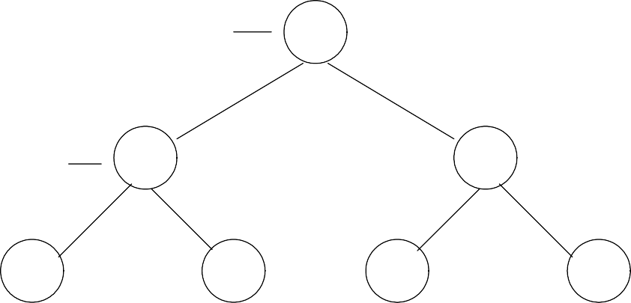
CS301 – Data Structures Lecture No. 24
balance of the node in favor of the right subtree is shown by a triangular knob tilted towards right. Now, the action required in this case to make the tree balanced again is:
Change the balance of the parent node and stop. There is no further effect on balance of any higher node.
In this case, the balance of the tree is changed from 0 to –1, which is within the defined limits of AVL tree, therefore, no rotation is performed in this case.
Below is a tree in which the height of the left subtree does not change after deleting
one node from it.
0
Fig 24.2
4
2
6
1
1
3
5
7
2
The node 4 is the root node, nodes 2 and 6 are on level 1 and nodes 1, 3, 5, 7 are shown on level 2. Now, if we delete the node 1, the balance of the node 2 is tilted towards right, it is –1. The balance of the root node 4 is unchanged as there is no change in the number of levels within right and left subtrees of it. Similarly, there is no change in the balances of other nodes. So we don’t need to perform any rotation operation in this case.
Let’s see the second case.
Case 1b: the parent of the deleted node had a balance of 0 and the node was deleted in the parent’s right subtree.
Delete on this side
tree is within the balance limits of AVL. A
Fig 24.3
On the left of Fig 24.3, the fter a node is
deleted from the right subtree of it. The balance of the tree is tilted towards left as shown in the right tree show in the Fig 24.3. Now, we see what action will be required to make the tree balanced again.
Change the balance of the parent node and stop. No further effect on balance of any higher node (same as 1a).
So in this case also, we don’t need to perform rotation as the tree is still an AVL (as

Slide 45
CS301 – Data Structures Lecture No. 24
we saw in the Case 1a). It is important to note that in both of the cases above, the balance of the parent node was 0. Now, we will see the cases when the balance of the parent node is not 0 previously.
Case 2a: The parent of the deleted node had a balance of 1 and the node was deleted in the parent’s left subtree.
Delete on
this side In the Fig 24.4
above, the tree on the left contains the ba
Fig 24.4
lance factor as 1, which
means that the left subtree of the parent node is one level more than the number of levels in the right subtree of it. When we delete one node from the left subtree of the
node, the height of the left subtree is changed and the balance becomes 0 as shown in the right side tree of Fig 24.4. But it is very important understand that this change of levels may cause the change of balance of higher nodes in the tree i.e.
Change the balance of the parent node. May have caused imbalance in higher nodes so continue up the tree.
So in order to ensure that the upper nodes are balanced, we calculate their balance factors for all nodes in higher levels and rotate them when required.
Case 2b: The parent of the deleted node had a balance of -1 and the node was deleted in the parent’s right subtree.
Similar to the Case 2a, we will do the following action:
Change the balance of the parent node. May have caused imbalance in higher nodes so continue up the tree.

Slide 46
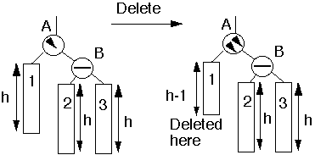
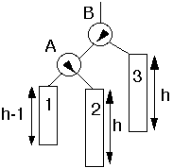
CS301 – Data Structures Lecture No. 24
Now, we see another case.
Case 3a:The parent had balance of -1 and the node was deleted in the parent’s left subtree, right subtree was balanced.
Fig 24.5
As shown in the left tree in Fig 24.5, the node A is tilted towards right but the right subtree of A (node B above) is balanced. The deleted node lies in the left subtree of the node A. After deletion, the height of the left subtree is changed to h-1 as depicted in the right tree of above figure. In this situation, we will do the following action:
Perform single rotation, adjust balance. No effect on balance of higher nodes so stop here.
Single rotate
Node A has become the left subtree of node B and node 2 left subtree of node B has become the right subtree of node A. The balance of node B is tiled towards left and
balance of node A is tilted towards right but somehow, both are within AVL limits. Hence, after a single rotation, the balance of the tree is restored in this case.

Slide 47
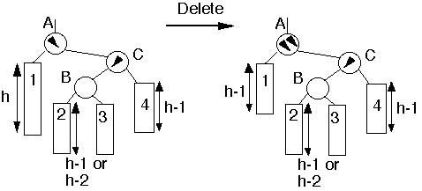
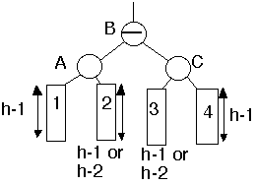
CS301 – Data Structures
Lecture No. 24
Case 4a: Parent had balance of -1 and the node was deleted in the parent’s left subtree, right subtree was unbalanced.
Fig 24.7
In the last case 3a, the right subtree of node A was balanced. But in this case, as shown in the figure above, the node C is tilted towards left. The node to be deleted lies in the left subtree of node A. After deleting the node the height of the left subtree of node A has become h-1. The balance of the node A is shown tilted towards right by showing two triangular knobs inside node A. So what is the action here.
Double rotation at B. May have affected the balance of higher nodes, so continue up the tree.
double rotate
Fig 24.8
Node A, which was the root node previously, has become the left child of the new root node B. Node C, which was the right child of the root node C has now become the right child of the new root node B.

Slide 48
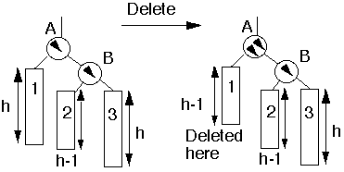
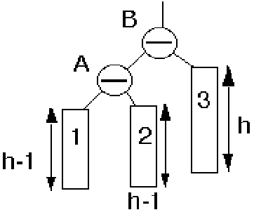
CS301 – Data Structures Lecture No. 24
Case 5a: The parent had balance of -1 and the node was deleted in the parent’s left subtree, right subtree was unbalanced.
Fig 24.9
In the figure above, the right tree of the node B has a height of h-1 while the right subtree is of height h. When we remove a node from the left subtree of node A, the new tree is shown on the right side of Fig 24.9. The subtree 1 has height h-1 now, while subtrees 2 and 3 have the same heights. So the action we will do in this case is:
Single rotation at B. May have effected the balance of higher nodes, so continue up the tr single
rotate
ee.
Fig 24.10
These were the five cases of deletion of a node from an AVL tree. Until now, we are trying to understand the concept using the figures. You might have noticed the phrase ‘continue up the tree’ in the actions above. How will we do it? One way is to maintain the pointer of the parent node inside each node. But often the easiest method when we go in downward direction and then upward is recursion. In recursion, the work to be done later is pushed on to the stack and we keep on moving forward until at a certain point we back track and do remaining work present in the stack. We delete a node when we reach at the desired location and then while traversing back, do the rotation operation on our way to the root node.
Symmetrical to case 2b, we may also have cases 3b, 4b and 5b. This should not be a problem in doing it yourself.

Slide 49
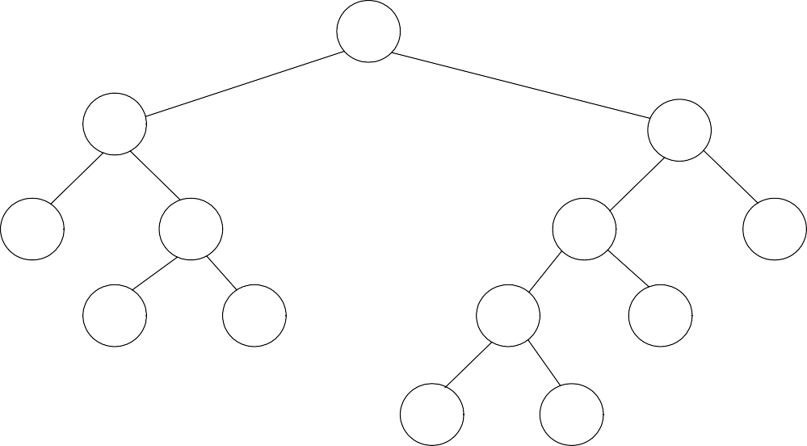
CS301 – Data Structures Lecture No. 24
Other Uses of Binary Trees
A characteristic of binary trees is that the values inside nodes on the left of a node are smaller than the value in the node. And the values inside the nodes on the right of a node are greater than the value in the node. This is the way a binary tree is constructed.
Whatever is the size of the tree, the search is performed after traversing upto log₂n
levels maximum.
We have observed that the binary tree becomes a linked list and it can become shallow. The AVL conditions came into picture to control the height balance of a binary tree. While searching in an AVL tree, in the worst case scenario we have to search 1.44 log₂n levels. For searches, binary and AVL trees are the most efficient but we do have some other kinds of trees that will be studied later.
Lets see what could be some other uses of binary trees, we start our discussion with
Expression Trees.
Expression Trees
Expression trees, the more general parse trees and abstract syntax trees are significant components of compilers.
We already know about compilers that whenever we write our program or code in
some computer language like C++ or Java. These programs are compiled into assembly language or byte code (in case of Java). This assembly language code is translated converted into machine language and an executable file is made by another program called the assembler.
By the way, if you have seen your syllabus, you might have seen that there is a
dedicated subject on compilers. We study in detail about compilers in that course. For this course, we will see expression or parse trees.
We will take some examples of expression trees and we will not delve into much depth of it rather that would be an introduction to expression trees.
(a+b*c)+((d*e+f)*g)
+
+
*
a
*
+
g
b
c
*
f
Fig 24.11
d
e

Slide 50
CS301 – Data Structures Lecture No. 24
You can see the infix expression above (a + b * c) + ( (d * e + f) * g), it is represented in the tree form also.
You can see from bottom of the tree that the nodes b and c in the nodes are present at the same level and their parent node is multiplication (*) symbol. From the expression
also, we see that the b and c are being multiplied. The parent node of a is + and right subtree of + is b*c. You might have understood already that this subtree is depicting a+b*c. On the right side, node d and e are connected to the parent *. Symbol + is the
parent of * and node f. The expression of the subtree at node + is d*e+f. The parent of node + is * node, its right subtree is g. So expression of the subtree at this node * is
(d*e+f)*g). The root node of the tree is +.
These expression trees are useful in compilers and in spreadsheets also, they are sometimes called parse trees.
Parse Tree in Compilers
See the expression tree of expression A := A + B * C below. We are adding B and C, adding the resultant in A and then finally assigning the resultant to A.
A := A + B * C
<assign>
<id>
:=
<expr>
A
<expr
+
<term
<term>
<factor>
<term>
*
<factor>
<id>
<factor>
<id>
Expression grammar
A
<id>
C
<assign>
<id>
<expr>
<term>
€ <id> := <expr>
€ A | B | C
€ <expr> + <term> | <term>
€ <term> * <factor> | <factor>
B
Fig 24.12
The root node in the parse tree shown above is <assign>.
The assignment statement (<assign>) has three parts. On the left of it, there is always an identifier (single or an array reference) called l-value. The l-value shown in the tree above is <id> and the identifier is A in the expression above. The second part of assignment statement is assignment operator (= or :=). One the right of assignment operator lies the third part of assignment statement, which is an expression. In the expression A := A + B * C above , the expression after assignment operator is A + B *
C. In the tree, it is represented by the node <expr>. The node <expr> has three subnodes: <expr>, + and <term>. <expr>’s further left subtree is <expr>, <term>,
<factor>, <id> and then finally is B. The right subchild <term> has further subnodes
as <term>, * and <factor>. <factor> has <id> as subchild and <id> has C.

Slide 51
CS301 – Data Structures
Lecture No. 24
Note the nodes in gray shade in the tree above form A = A + B * C.
Compiler creates these parse trees. We will see how to make these trees, when we will parse any language tree like C++. Parsing mean to read and then extract the required structure. A compiler parses a computer language like C++ to form parse trees. Similarly, when we do speech recognition. Each sentence is broken down into a certain structure in form of a tree. Hand writing recognition also involves this. The tablet PCs these days has lot of implementation of parse trees.
Parse Tree for an SQL Query
Let’s see another example of parse trees inside databases. The parse trees are used in query processing. The queries are questions to the databases to see a particular kind of data. Consider you have a database for a video store that contains data of movies and artists etc. You are querying that database to find the titles of movies with stars born in 1960. The language used to query from the database is called SQL (Structured Query Language), this language will be dealt in depth in the databases course. The tables lying in this movies database are:
StarsIn(title, year, starName) MovieStar(name, address, gender, birthdate)
The following SQL query is used to retrieve information from this database:
SELECT title
FROM StarsIn, MovieStar
WHERE starName = name AND birthdate LIKE ‘%1960’ ;
This query is asking to retrieve the titles of those movies from StarsIn and MovieStar tables where the birthdate of an actor is 1960. We see in query processing a tree is formed as shown in the figure below:
< Query >
SELECT <SelList>
FROM
<FromList>
WHERE
<Condition>
<Attribute>
<RelName>
,
<FromList>
AND
title
StarsIn
<RelName>
MovieStar
Condition
Condition
Fig 24.13
<Attribute>
=
<Attribute>
<Attribute>
LIKE
<Pattern>
setName
name
birthdate
‘%1960’
The root node is Query. This node is further divided into SELECT, <SelList>, FROM, <FromList>, WHERE and <Condition> subnodes. <SelList> will be an Attribute and finally a title is reached. Observe the tree figure above, how the tree is expanded when we go in the downward direction. When the database engine does the query process, it makes these trees. The database engine also performs query

Slide 52
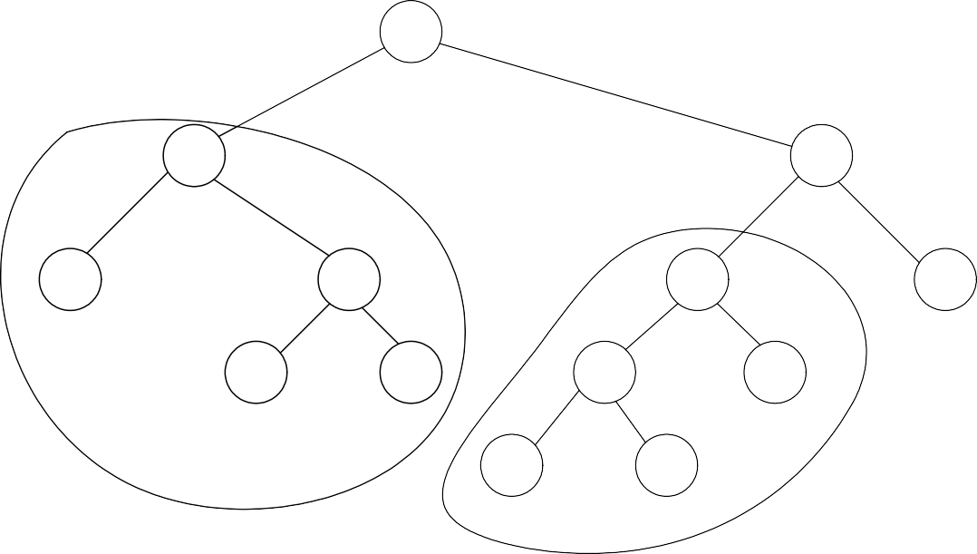
CS301 – Data Structures
Lecture No. 24
optimization using these trees.
Compiler Optmization
Let’s see another expression tree here:
Common subexpression: (f+d*e) + ((d*e+f)*g)
+
+
*
f
*
+
g
d
e
*
f
d
e
Fig 24.14
The root node is +, left subtree is capturing the f+d*e expression while the right subtree is capturing (d*e+f)*g.
Normally compilers has intelligence to look at the common parts inside parse trees. For example in the tree above, the expressions f+d*e and d*e+f are same basically. These common subtrees are called common subexpressions. To gain efficiency,
instead of calculating the common subexpressions again, the compilers calculates them once and use them at other places. The part of the compiler that is responsible to
do this kind of optimization is called optimizer.
See the figure below, the optimizer (part of compiler) will create the following graph while performing the optimization. Because both subtrees were equivalent, it has taken out one subtree and connected the link from node * to node +.

Slide 53
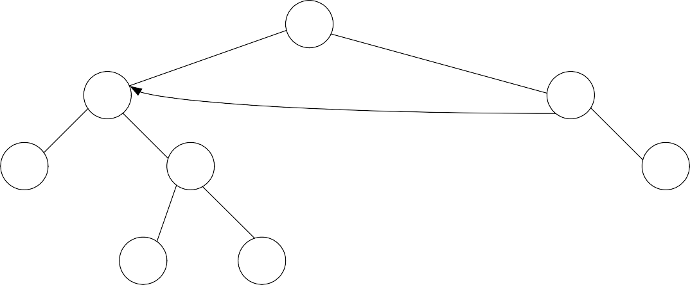
CS301 – Data Structures
Lecture No. 24
(Common Subexpression: (f+d*e) + ((d*e+f)*g)
+
+
*
f
*
Graph!
g
d
e
Fig 24.15
This figure is not a tree now because it has two or more different paths to reach a node. Therefore, this has become a graph. The new connection is containing a directed edge, which is there in graphs.
Optimizer uses the expressions trees and converts them to graphs for efficiency purposes. You read out from your book, how the expression trees are formed, what
are the different methods of creating them.

Slide 54
CS301 – Data Structures
Lecture No. 25
Data Structures Lecture No. 25
Reading Material
Data Structures and Algorithm Analysis in C++
Chapter. 4, 10
4.2.2, 10.1.2
Summary
•
•
Expression tree Huffman Encoding
Expression tree
We discussed the concept of expression trees in detail in the previous lecture. Trees are used in many other ways in the computer science. Compilers and database are two major examples in this regard. In case of compilers, when the languages are translated into machine language, tree-like structures are used. We have also seen an example of expression tree comprising the mathematical expression. Let’s have more discussion on the expression trees. We will see what are the benefits of expression trees and how can we build an expression tree. Following is the figure of an expression tree.
+
+
*
a
*
+
g
b
c
*
f
d
e
In the above tree, the expression on the left side is a + b * c while on the right side,
we have d * e + f * g. If you look at the figure, it becomes evident that the inner nodes contain operators while leaf nodes have operands. We know that there are two types of nodes in the tree i.e. inner nodes and leaf nodes. The leaf nodes are such nodes which have left and right subtrees as null. You will find these at the bottom level of the tree. The leaf nodes are connected with the inner nodes. So in trees, we have some inner nodes and some leaf nodes.
In the above diagram, all the inner nodes (the nodes which have either left or right

Slide 55
CS301 – Data Structures Lecture No. 25
child or both) have operators. In this case, we have + or * as operators. Whereas leaf nodes contain operands only i.e. a, b, c, d, e, f, g. This tree is binary as the operators are binary. We have discussed the evaluation of postfix and infix expressions and have seen that the binary operators need two operands. In the infix expressions, one operand is on the left side of the operator and the other is on the right side. Suppose, if we have + operator, it will be written as 2 + 4. However, in case of multiplication, we will write as 5*6. We may have unary operators like negation (-) or in Boolean expression we have NOT. In this example, there are all the binary operators. Therefore, this tree is a binary tree. This is not the Binary Search Tree. In BST, the values on the left side of the nodes are smaller and the values on the right side are greater than the node. Therefore, this is not a BST. Here we have an expression tree with no sorting process involved.
This is not necessary that expression tree is always binary tree. Suppose we have a unary operator like negation. In this case, we have a node which has (-) in it and there is only one leaf node under it. It means just negate that operand.
Let’s talk about the traversal of the expression tree. The inorder traversal may be executed here.
+
+
*
a
*
+
g
b
c
*
f
d
e
Inorder traversal yields: a+b*c+d*e+f*g
We use the inorder routine and give the root of this tree. The inorder traversal will be a+b*c+d*e+f*g. You might have noted that there is no parenthesis. In such expressions when there is addition and multiplication together, we have to decide which operation should be performed first. At that time, we have talked about the operator precedence. While converting infix expression into postfix expression, we have written a routine, which tells about the precedence of the operators like multiplication has higher precedence than the addition. In case of the expression 2 + 3
* 4, we first evaluate 3 * 4 before adding 2 to the result. We are used to solve such
expressions and know how to evaluate such expressions. But in the computers, we have to set the precedence in our functions.
We have an expression tree and perform inorder traversal on it. We get the infix form of the expression with the inorder traversal but without parenthesis. To have the

Slide 56
CS301 – Data Structures Lecture No. 25
parenthesis also in the expressions, we will have to do some extra work.
Here is the code of the inorder routine which puts parenthesis in the expression.
/* inorder traversal routine using the parenthesis */
void inorder(TreeNode<int>* treeNode)
{
if( treeNode != NULL ){
cout << "(";
inorder(treeNode->getLeft()); cout << ")";
cout << *(treeNode->getInfo());
cout << "(";
inorder(treeNode->getRight()); cout << ")";
}
}
This is the same inorder routine used by us earlier. It takes the root of the tree to be traversed. First of all, we check that the root node is not null. In the previous routine after the check, we have a recursive call to inorder passing it the left node, print the info and then call the inorder for the right node. Here we have included parenthesis using the cout statements. We print out the opening parenthesis ‘(‘before the recursive
call to inorder. After this, we close the parenthesis. Then we print the info of the node and again have opening parenthesis and recursive call to inorder with the right node before having closing parenthesis in the end. You must have understood that we are using the parenthesis in a special order. We want to put the opening parenthesis before the start of the expression or sub expression of the left node. Then we close the parenthesis. So inside the parenthesis, there is a sub expression.
On executing this inorder routine, we have the expression as ( a + ( b * c )) + ((( d * e
) + f ) * g ).

Slide 57
CS301 – Data Structures
Lecture No. 25
+
+
*
a
*
+
g
b
c
*
f
d
e
Inorder: ( a + ( b * c )) + ((( d * e ) + f ) * g )
We put an opening parenthesis and start from the root and reach at the node ‘a’. After reaching at plus (+), we have a recursive call for the subtree *. Before this recursive call, there is an opening parenthesis. After the call, we have a closing parenthesis. Therefore the expression becomes as (a + ( b * c )). Similarly we recursively call the right node of the tree. Whenever, we have a recursive call, there is an opening parenthesis. When the call ends, we have a closing parenthesis. As a result, we have an expression with parenthesis, which saves a programmer from any problem of precedence now.
Here we have used the inorder traversal. If we traverse this tree using the postorder mode, then what expression we will have? As a result of postorder traversal, there will be postorder expression.
+
+
*
a
*
+
g
b
c
*
f
d
e
Postorder traversal: a b c * + d e * f + g * +
This is the same tree as seen by us earlier. Here we are performing postorder traversal. In the postorder, we print left, right and then the parent. At first, we will print a.

Slide 58
CS301 – Data Structures Lecture No. 25
Instead of printing +, we will go for b and print it. This way, we will get the postorder traversal of this tree and the postfix expression of the left side is a b c * + while on the right side, the postfix expression is d e * f + g * +. The complete postfix expression is a b c * + d e * f + g * +. The expression undergoes an alteration with the change in the traversal order. If we have some expression tree, there may be the infix, prefix and postfix expression just by traversing the same tree. Also note that in the postfix form, we do not need parenthesis.
Let’s see how we can build this tree. We have some mathematical expressions while having binary operators. We want to develop an algorithm to convert postfix expression into an expression tree. This means that the expression should be in the postfix form. In the start of this course, we have seen how to covert an infix expression into postfix expression. Suppose someone is using a spreadsheet program and typed a mathematical expression in the infix form. We will first convert the infix expression into the postfix expression before building expression tree with this postfix expression.
We already have an expression to convert an infix expression into postfix. So we get the postfix expression. In the next step, we will read a symbol from the postfix expression. If the symbol is an operand, put it in a tree node and push it on the stack. In the postfix expression, we have either operators or operands. We will start reading the expression from left to right. If the symbol is operand, make a tree node and push it on the stack. How can we make a tree node? Try to memorize the treeNode class. We pass it some data and it returns a treeNode object. We insert it into the tree. A programmer can also use the insert routine to create a tree node and put it in the tree.
Here we will create a tree node of the operand and push it on the stack. We have been using templates in the stack examples. We have used different data types for stacks like numbers, characters etc. Now we are pushing treeNode on the stack. With the help of templates, any kind of data can be pushed on the stack. Here the data type of the stack will be treeNode. We will push and pop elements of type treeNode on the stack. We will use the same stack routines.
If symbol is an operator, pop two trees from the stack, form a new tree with operator as the root and T1 and T2 as left and right subtrees and push this tree on the stack. We are pushing operands on the stacks. After getting an operator, we will pop two operands from the stack. As our operators are binary, so it will be advisable to pop two operands. Now we will link these two nodes with a parent node. Thus, we have the binary operator in the parent node.
Let’s see an example to understand it. We have a postfix expression as a b + c d e + *
*. If you are asked to evaluate it, it can be done with the help of old routine. Here we want to build an expression tree with this expression. Suppose that we have an empty stack. We are not concerned with the internal implementation of stack. It may be an array or link list.
First of all, we have the symbol a which is an operand. We made a tree node and push it on the stack. The next symbol is b. We made a tree node and pushed it on the stack. In the below diagram, stack is shown.

Slide 59
CS301 – Data Structures
Lecture No. 25
a b + c d e + * *
top
a
b
If symbol is an operand, put it in a one node tree and push it on a stack.
Our stack is growing from left to right. The top is moving towards right. Now we have two nodes in the stack. Go back and read the expression, the next symbol is + which is an operator. When we have an operator, then according to the algorithm, two operands are popped. Therefore we pop two operands from the stack i.e. a and b. We made a tree node of +. Please note that we are making tree nodes of operands as well as operators. We made the + node parent of the nodes a and b. The left link of the node + is pointing to a while right link is pointing to b. We push the + node in the stack.
a b + c d e + * *
+
a b
If symbol is an operator, pop two trees from the stack, form a new tree with operator as the root and T₁ and T₂ as left and right subtrees and push this tree on the stack.
Actually, we push this subtree in the stack. Next three symbols are c, d, and e. We made three nodes of these and push these on the stack.

Slide 60
CS301 – Data Structures
Lecture No. 25
a b + c d e + * *
+
c
d
e
a
b
Next we have an operator symbol as +. We popped two elements i.e. d and e and linked the + node with d and e before pushing it on the stack. Now we have three
nodes in the stack, first + node under which there are a and b. The second node is c
while the third node is again + node with d and e as left and right nodes.
a b + c d e + * *
+
c
+
a
b
d
e
The next symbol is * which is multiplication operator. We popped two nodes i.e. a subtree of + node having d and e as child nodes and the c node. We made a node of *
and linked it with the two popped nodes. The node c is on the left side of the * node and the node + with subtree is on the right side.

Slide 61
CS301 – Data Structures
Lecture No. 25
a b + c d e + * *
+
*
a
b
c
+
d
e
The last symbol is the * which is an operator. The final shape of the stack is as under:
a b + c d e + * *
*
+
*
a
b
c
+
d
e
In the above figure, there is a complete expression tree. Now try to traverse this tree in the inorder. We will get the infix form which is a + b * c * d + e. We don’t have parenthesis here but can put these as discussed earlier.

Slide 62
CS301 – Data Structures Lecture No. 25
This is the way to build an expression tree. We have used the algorithm to convert the infix form into postfix form. We have also used stack data structure. With the help of templates, we can insert any type of data in the stack. We have used the expression tree algorithm and very easily built the expression tree.
In the computer science, trees like structures are used very often especially in compilers and processing of different languages.
Huffman Encoding
There are other uses of binary trees. One of these is in the compression of data. This is known as Huffman Encoding. Data compression plays a significant role in computer networks. To transmit data to its destination faster, it is necessary to either increase the data rate of the transmission media or simply send less data. The data compression is used in computer networks. To make the computer networks faster, we have two options i.e. one is to somehow increase the data rate of transmission or somehow send the less data. But it does not mean that less information should be sent or transmitted. Information must be complete at any cost.
Suppose you want to send some data to some other computer. We usually compress the file (using winzip) before sending. The receiver of the file decompresses the data before making its use. The other way is to increase the bandwidth. We may want to use the fiber cables or replace the slow modem with a faster one to increase the network speed. This way, we try to change the media of transmission to make the network faster. Now changing the media is the field of electrical or communication engineers. Nowadays, fiber optics is used to increase the transmission rate of data.
With the help of compression utilities, we can compress up to 70% of the data. How can we compress our file without losing the information? Suppose our file is of size 1 Mb and after compression the size will be just 300Kb. If it takes ten minutes to transmit the 1 Mb data, the compressed file will take 3 minutes for its transmission. You have also used the gif images, jpeg images and mpeg movie files. All of these standards are used to compress the data to reduce their transmission time. Compression methods are used for text, images, voice and other types of data.
We will not cover all of these compression algorithms here. You will study about algorithms and compression in the course of algorithm. Here, we will discuss a special compression algorithm that uses binary tree for this purpose. This is very simple and efficient method. This is also used in jpg standard. We use modems to connect to the internet. The modems perform the live data compression. When data comes to the modem, it compresses it and sends to other modem. At different points, compression is automatically performed. Let’s discuss Huffman Encoding algorithm.
Huffman code is method for the compression of standard text documents. It makes use of a binary tree to develop codes of varying lengths for the letters used in the original message. Huffman code is also part of the JPEG image compression scheme. The algorithm was introduced by David Huffman in 1952 as part of a course assignment at MIT.
Now we will see how Huffman Encoding make use of the binary tree. We will take a

Slide 63
CS301 – Data Structures Lecture No. 25
simple example to understand it. The example is to encode the 33-character phrase: "traversing threaded binary trees"
In the phrase we have four words including spaces. There is a new line character in the end. The total characters in the phrase are 33 including the space. We have to send this phrase to some other computer. You know that binary codes are used for alphabets and other language characters. For English alphabets, we use ASCII codes. It normally consists of eight bits. We can represent lower case alphabets, upper case alphabets, 0,1,…9 and special symbols like $, ! etc while using ASCII codes. Internally, it consists of eight bits. If you have eight bits, how many different patterns you can be have? You can have 256 different patterns. In English, you have 26 lower case and 26 upper case alphabets. If you have seen the ASCII table, there are some printable characters and some unprintable characters in it. There are some graphic characters also in the ASCII table.
In our example, we have 33 characters. Of these, 29 characters are alphabets, 3 spaces and one new line character. The ASCII code for space is 32 and ASCII code for new line character is 10. The ASCII value for ‘a’ is 95 and the value of A is 65. How many bits we need to send 33 characters? As every character is of 8 bits, therefore for 33 characters, we need 33 * 8 = 264. But the use of Huffman algorithm can help send the same message with only 116 bits. So we can save around 40% using the Huffman algorithm.
Let’s discuss how the Huffman algorithm works. The algorithm is as:
List all the letters used, including the "space" character, along with the frequency with which they occur in the message.
Consider each of these (character, frequency) pairs to be nodes; they are
actually leaf nodes, as we will see.
Pick the two nodes with the lowest frequency. If there is a tie, pick randomly amongst those with equal frequencies.
Make a new node out of these two, and turn two nodes into its children.
This new node is assigned the sum of the frequencies of its children.
Continue the process of combining the two nodes of lowest frequency till the time only one node, the root is left.
Let’s apply this algorithm on our sample phrase. In the table below, we have all the characters used in the phrase and their frequencies.
Original text: traversing threaded binary trees size: 33 characters (space and newline)
Letters : | Frequency
NL : | 1
SP : | 3
a : | 3

Slide 64
CS301 – Data Structures
Lecture No. 25
b : | 1
d : | 2
e : | 5
g : | 1
h : | 1
The new line occurs only once and is represented in the above table as NL. Then white space occurs three times. We counted the alphabets that occur in different words. The letter a occurs three times, letter b occurs just once and so on.
Now we will make tree with these alphabets and their frequencies.
2 is equal to sum of the frequencies of the two children nodes.
a 3
t 3
e 5
r 5
d 2
i n
2 2
s 2
2
SP 3
NL 1
b g
1 1
h 1
v 1
y 1
We have created nodes of all the characters and written their frequencies along with the nodes. The letters with less frequency are written little below. We are doing this for the sake of understandings and need not to do this in the programming. Now we will make binary tree with these nodes. We have combined letter v and letter y nodes with a parent node. The frequency of the parent node is 2. This frequency is calculated by the addition of the frequencies of both the children.
In the next step, we will combine the nodes g and h. Then the nodes NL and b are combined. Then the nodes d and i are combined and the frequency of their parent is the combined frequency of d and i i.e. 4. Later, n and s are combined with a parent node. Then we combine nodes a and t and the frequency of their parent is 6. We continue with the combining of the subtree with nodes v and y to the node SP. This way, different nodes are combined together and their combined frequency becomes the frequency of their parent. With the help of this, subtrees are getting connected to each other. Finally, we get a tree with a root node of frequency 33.

Slide 65
CS301 – Data Structures
Lecture No. 25
33
14
19
6
8
9
10
a 3
t 3
4
4
4
e 5
r 5
5
d 2
i n
2 2
s 2
2
2
2
SP 3
NL 1
b g
1 1
h 1
v 1
y 1
We get a binary tree with character nodes. There are different numbers with these nodes that represent the frequency of the character. So far, we have learnt how to make a tree with the letters and their frequency. In the next lecture, we will discuss the ways to compress the data with the help of Huffman Encoding algorithm.

